Slide 1

The Noble Gases

Slide 2
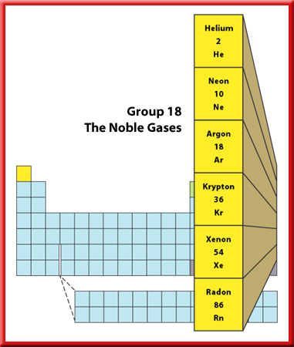
Representative Elements
2
Group 18—The Noble Gases
The Group18 elements are called the noble gases.
This is because they rarely combine with other elements and are found only as uncombined elements in nature.
Their reactivity is very low.

Slide 3

Representative Elements
2
Group 18—The Noble Gases
Helium is less dense than air, so it’s great for all kinds of balloons.
Helium balloons lift instruments into the upper atmosphere to measure atmospheric conditions.

Slide 4
Representative Elements
2
Group 18—The Noble Gases
Even though hydrogen is lighter than helium, helium is preferred for these purposes
because helium will not burn.

Slide 5

Representative Elements
2
Uses for the Noble Gases
The “neon” lights you see in advertising signs can contain any of the noble gases, not just neon.
Electricity is passed through the glass tubes that make up the sign.

Slide 6
Representative Elements
2
Uses for the Noble Gases
The electricity causes the gas to glow.
Each noble gas produces a unique color.
Helium glows yellow, neon glows red-orange, and argon produces a bluish-violet color.

Slide 7
Representative Elements
2
Uses for the Noble Gases
Argon, the most abundant of the noble gases on Earth, was first found in 1894.
Krypton is used with nitrogen in ordinary lightbulbs because these gases keep the glowing filament from burning out.
Krypton lights are used to illuminate landing strips at airports, and xenon is used in strobe lights and was once used in photographic flash cubes.

Slide 8
Representative Elements
2
Uses for the Noble Gases
At the bottom of the group is radon, a radioactive gas produced naturally as uranium decays in rocks and soil.
If radon seeps into a home, the gas can be harmful because it continues to emit radiation.
When people breathe the gas over a period of time, it can cause lung cancer.

Slide 9
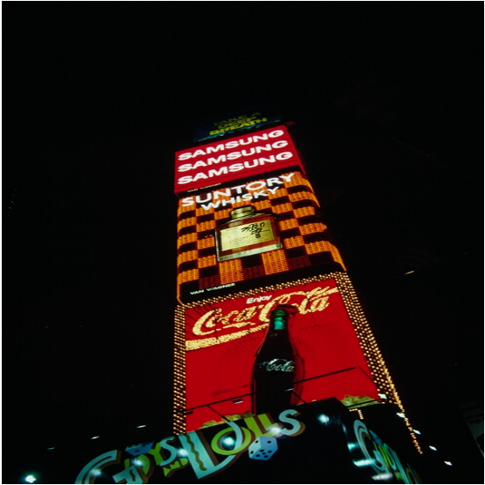
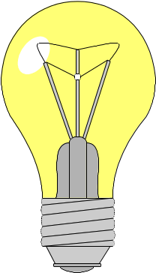
Group 18/0 – The Noble gases
Some facts…
1) All of the noble gases have a full outer shell, so they are very _____________
2) They all have low melting and boiling points
3) They exist as single atoms rather then diatomic molecules
Helium is lighter then air and is used in balloons and airships (as well as for talking in a silly voice)
Argon is used in light bulbs (because it is so unreactive) and argon , krypton and neon are used in fancy lights

Slide 10
This powerpoint was kindly donated to www.worldofteaching.com
http://www.worldofteaching.com is home to over a thousand powerpoints submitted by teachers. This is a completely free site and requires no registration. Please visit and I hope it will help in your teaching.

